Slide 1
Employee Data Analysis using Excel
STUDENT NAME:SHRIRAM R
REGISTER NO: [122203466]
24A9779E5DD1350925D4BAD8876BC5C0
DEPARTMENT: B.COM [C.S]
COLLEGE: ST THOMAS COLLEGE OF ARTS & SCIENCE

Slide 2
PROJECT TITLE
Employee Performance Analysis using Excel

Slide 3


AGENDA
Problem Statement
Project Overview
End Users
Our Solution and Proposition
Dataset Description
Modelling Approach
Results and Discussion
Conclusion
3/21/2024 Annual Review

Slide 4

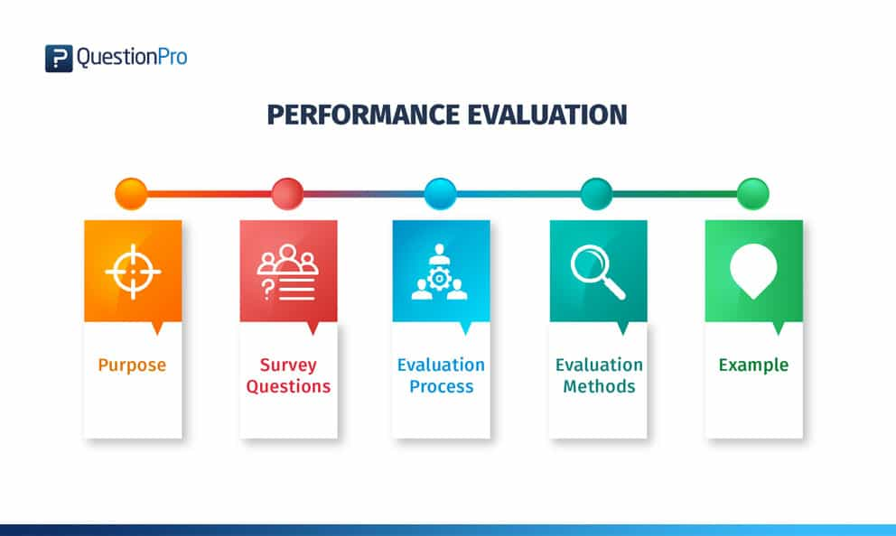
PROBLEM STATEMENT
Employee performance analysis using excel involves evaluating and measuring an employee’s work effectiveness and efficiency based on key performance indicators (KPIs). This data is then analyzed using excel’s functions and tools, such as pivot tables, charts, and conditional formatting, to identify patterns, strengths and area for improvement. The analysis helps the HR, managers and supervisors in order to make informed decisions regarding training needs, promotions, and overall workforce optimization.

Slide 5

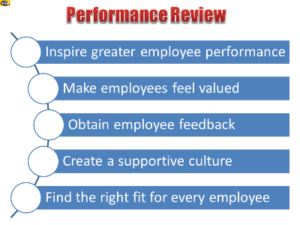
PROJECT OVERVIEW
Given that the data of the employees is provided . We’re analyzing
The data sets given within the employee data for calculating employee
Performance analysis. The datasets included in the analysis are
First name, business unit, performance level and so on & so forth.
This analysis will be used find the employees performance ratings
To decide (by the HR) to see whether which employees is in need of training,
Which employees will incentives and which employees will ousted
For poor performance.
.

Slide 6
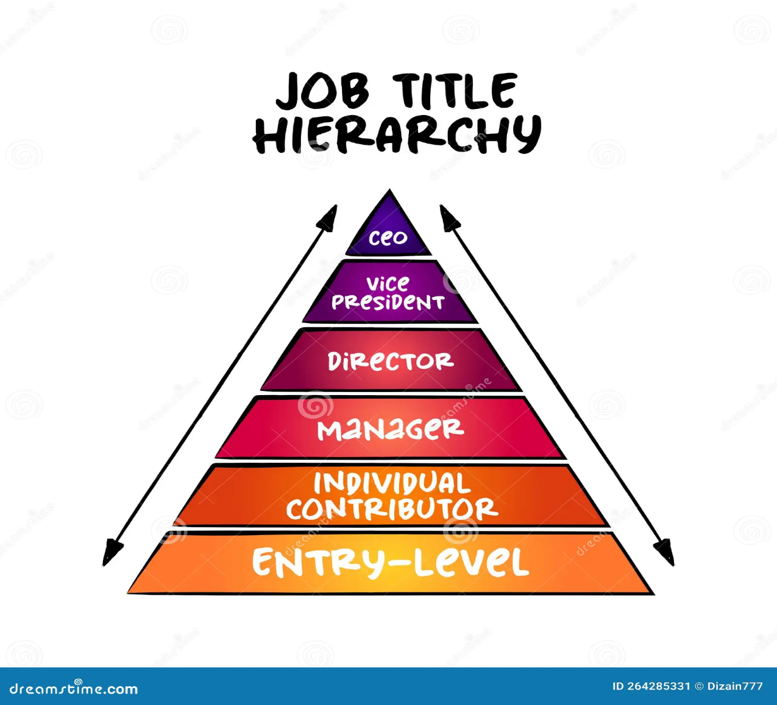

WHO ARE THE END USERS?
Apart from that list there is also the “organization” itself, the “HR” and “many other individuals” & departments who are use this type of analysis to achieve their own objectives that they’ve been
Assigned to which, at it’s core is to focus on profits
Retained by organization which will it in the long run such as its capability survive in the future market conditions.
Human resource (HR) managers
Department managers/supervisors
Senior management/excutivees
employees

Slide 7

OUR SOLUTION AND ITS VALUE PROPOSITION
Data-Driven Insights: Enables managers to make informed decisions based on accurate, real-time performance data,
Improved Efficiency: Automates the data collection and analysis process, saving time and reducing manual errors.
Enhanced Employee Development: Identifies training needs and development opportunities, leading to a more skilled workforce.
Better Performance Management: Helps in recognizing top performers and addressing underperformance, ultimately improving overall productivity.
Cost-Effective Solution: Leverages the widely accessible Excel platform, avoiding the need for expensive software or tools.

Slide 8
Dataset Description
Employee data:- Kaggle
Total features the dataset consists of:- 26 features
The features which were used in the analysis:- 10 features
The 10 features used in the analysis:-
i)EMP ID: numerical value
ii)First name: text format
iii)Last name : text format
iv)Business unit: text format [BPC, CCDR, EW, MSC, NEL, PL, PYZ, SNG, TNS, WBL]
v)Employee status: text format [active, future start]
vi)Employee type: text format [ full-time, contract ]
vii)Employee class: text format [ temperary, part-time, full-time]
viii)Current employee rating: numerical values [1 to 5]
ix)Performance level: text format [low, med, high, very high]
x) Gender code: [male, female]

Slide 9

THE "WOW" IN OUR SOLUTION
Performance level formula used in the analysis:-
=IFS(Z8>=5,"VERY HIGH",Z8>=4,"HIGH",Z8>=3,"MED","TRUE","LOW")
Predictive analytics: integrating predictive models to forecast future performance trends
Based on historical data, giving managers a proactive approach to workforce planning.
Automated Alerts: The tools can be set up to send automated alerts for critical performance
issued, ensuring that managers are immediately notified when attention is
needed.
3/21/2024 Annual Review
9

Slide 10
MODELLING
Data collection:
1)Collected the data from edunet dashboard for employee data excel
2) Collected the data from edunet dashboard for employee dataset ppt
3) Analysing the data to perform employee performance analysis
Data cleaning:
1)Identifying the blank spaces to then,
2)Removing the blank spaces from the data to make it easier to analyse
3)Highlighting the columns which used in the analysis process
Performance level calculation:
1)Changing the employee rating part which is numerical value into text format
2)Create new column name it “performance level”
3)Enter the formula to categorize the rating from numerical rating to text format
4)Categorize the rating into 4 sets low (below 3), med (3), high (4), very high(5)
10

Slide 11
RESULTS
11

Slide 12
conclusion
Therefore, the results conclude that the employees who are performing who are
Performing med i.e., medium are numbers the highest but on the off note their
Presence is rather consistent to say the least. But doesn’t mean we can ignore the other
Levels take low for instance it was constant for 6 out 10 business units where CCDR being
Highest and BPC being the lowest. Across the units it’s seems need to have serious
Management supervising and guidance for the employees to have meet at the
High and very high. It is merely recommendation for the HR they are free to take the
Decisions as they more interactions with the employees of the organization.

